Slide 1
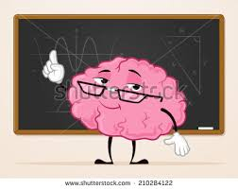
The Teen Brain
Cognitive Development of the Adolescent Brain
Traci Chudy

Slide 2
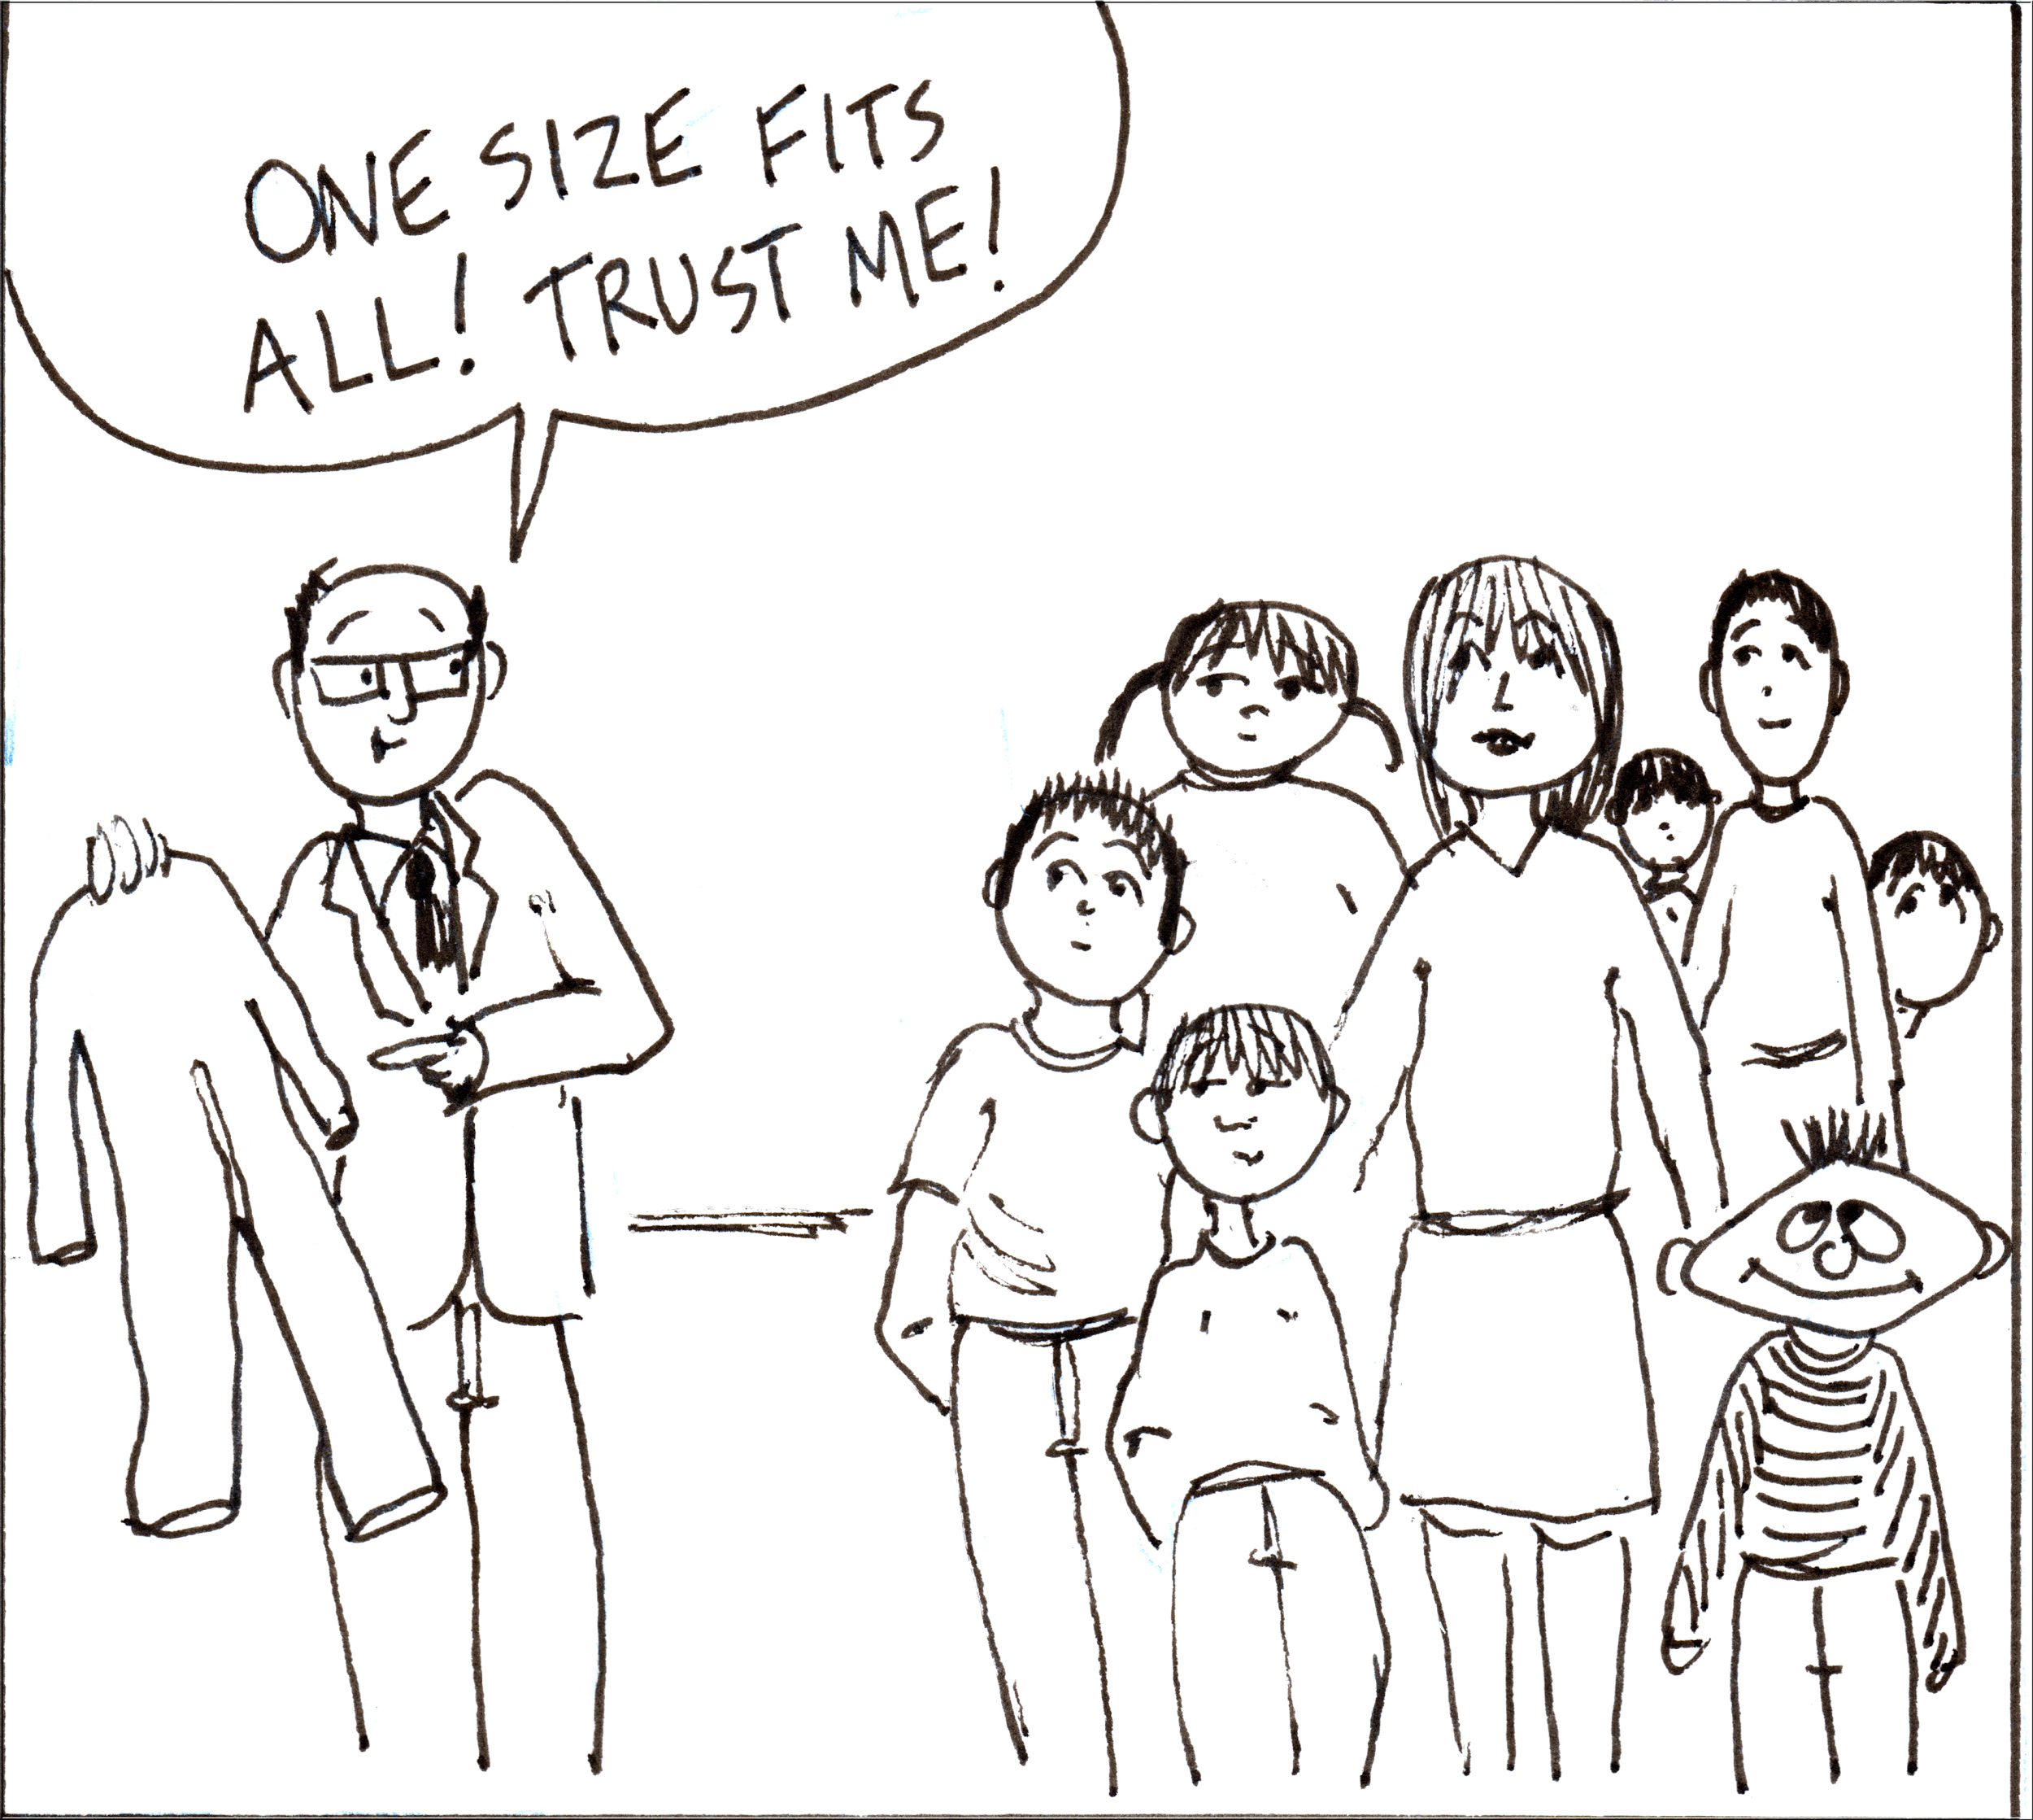

Slide 3


Slide 4
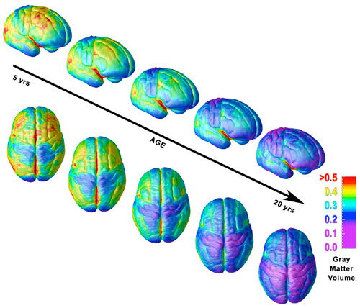
The Adolescent Brain
Notes:
Because of new technologies, scientists have been able to take MRI’s of the brain at different ages and follow specific children to see how the brain develops.
It was once thought that the only major brain growth occurred before age 5 but it is now known that during adolescents there is another drastic change. It begins when a child hits puberty and continues until about the age of 25. The period of “adolescence” is considered to be from the beginning of puberty until an individual develops a stable, independent role in society. (Officially a grown-up)
If you look at the 5 yr old’s brain, very little has developed. The preteen’s brain looks much more like a 5 yr old’s than it does of a teenager or adult- yet we tend to expect them to act perfectly and behave and make decisions like an adult would. The teen brain is undergoing that huge transformation to becoming a fully developed adult brain, capable of seeing others’ perspectives and able to understand and think about long term consequences of actions/words and able to STOP the impulse to “act before thinking”.

Slide 5
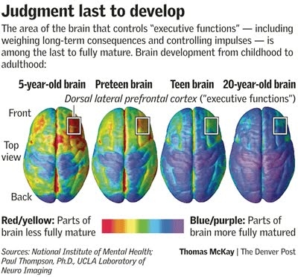
Notes:
This diagram shows the part of the brain that controls “executive functions”, (which are those consequences and impulses) are the LAST part of the brain to fully develop.
The red/yellow parts show the brain less fully mature. The blue/purple areas are more fully mature.
Notice the preteen brain and how less developed it is in the “impulse” area. Sometimes, we see our kids as “little” adults and forget that brain development plays into their behaviors.
We also know that the ability to take into account someone else’s perspective is not fully developed until adulthood.

Slide 6
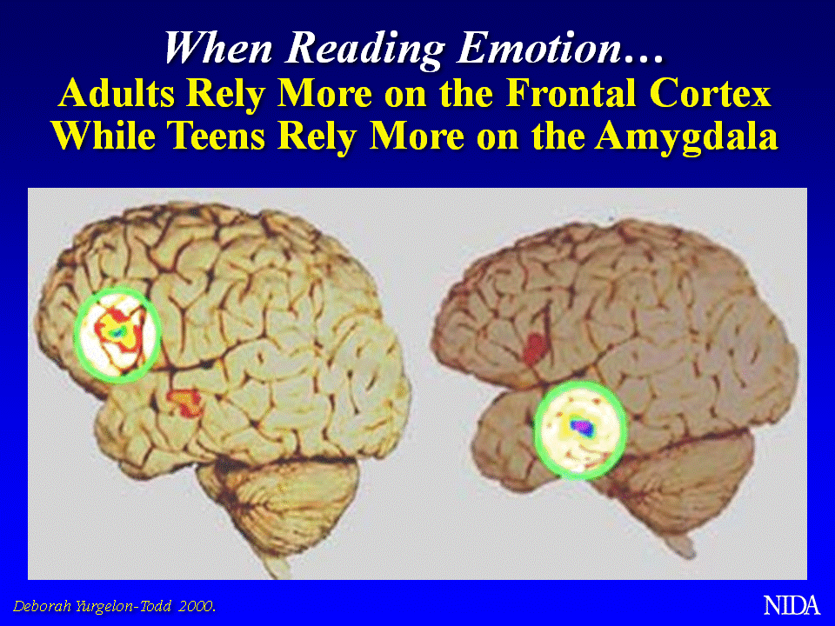
Notes:
Adults have the ability to control impulses and weigh the consequences of an action because our Frontal Cortex is fully developed. Because that part of the brain is the last to develop, teens must rely on their limbic system to guide them. This is the EMOTION center of the brain. (That explains why teens tend to “overreact” and why they become so sensitive about everything we as parents say and why they become so moody.)
Their Amygdala is literally swells when they become anxious or scared or even mad. All other functions of the brain quiet down and focus on the Amygdala - it’s our fight or flight reflex. Until we calm the amygdala, the brain will not be able to properly function- A great example of that is test anxiety. If students become anxious before a test, the amygdala swells and the part of the brain that holds all of that information they memorized and studied cannot be accessed fully. Students (and adults) must learn strategies to “calm” their amygdala/limbic system in order to allow the brain to recall all of the information it needs.
We as parents can try to think of their
impulsiveness as future boldness and independent thinking,
moodiness as a source of new found or future empathy,
excitability as future passion for something.

Slide 7

Neuroscientist
Sarah-Jayne Blakemore
Notes:
Pose question: How does what she talks about in the video apply to what you see in the classroom? Why?

Slide 8

The Neuroanatomical Transformation of the Teenage Brain
With
Jill Bolte Taylor

Slide 10

What does this mean for students?
    Note Taking
    Study Skills
Notes:
How students take notes and study should match their brain dominance.
Left brain people learn better in black and white. Text books and worksheets are made for left brain people.
Right brain people learn better in color and with pictures. They need to add color to their notes and study guides. (Color coding and adding pictures)
Students understanding their brain dominance and applying strategies designed specifically for their brain dominance will improve long term memory of information.

Slide 11
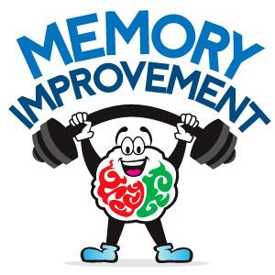
Working Memory | Long Term memory
Short term memorizing “Cramming” Learned material only makes it to your “working memory” Learned material will soon be forgotten | Learned material makes it to your “long-term memory” Review and revisit material often Information should be reviewed ten minutes after learning and every seven days to keep in long-term memory

Slide 12
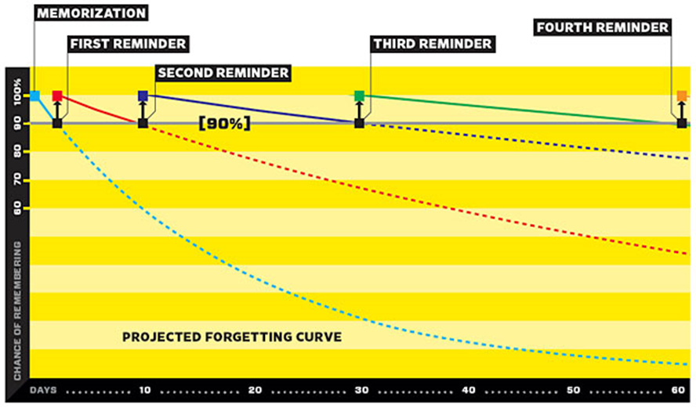

Slide 13
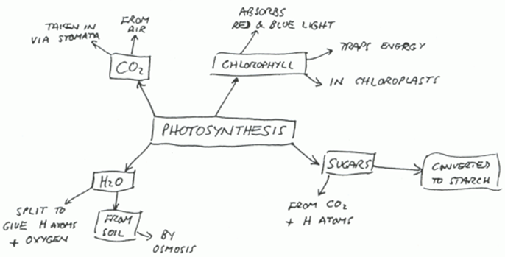
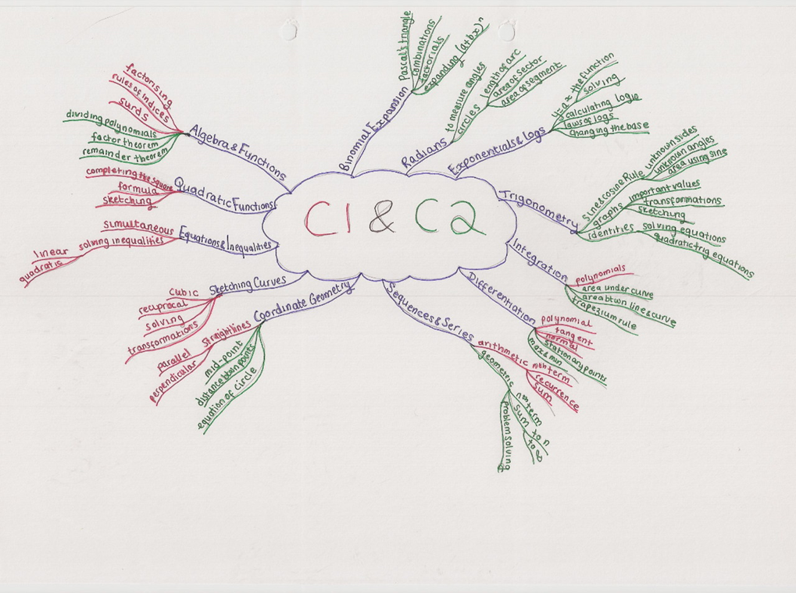
Notes:
Left:
Left brain dominant student Rt: Right brain dominant student. (This would drive a left brainer CRAZY!)
Left Brain dominant people learn in black and white. Text books and worksheets are made for left brain people. Left brain people are also usually auditory so lectures suite them as well.
Right brain dominant people learn better with color and pictures. They need visuals and sometimes hands on learning.

Slide 14
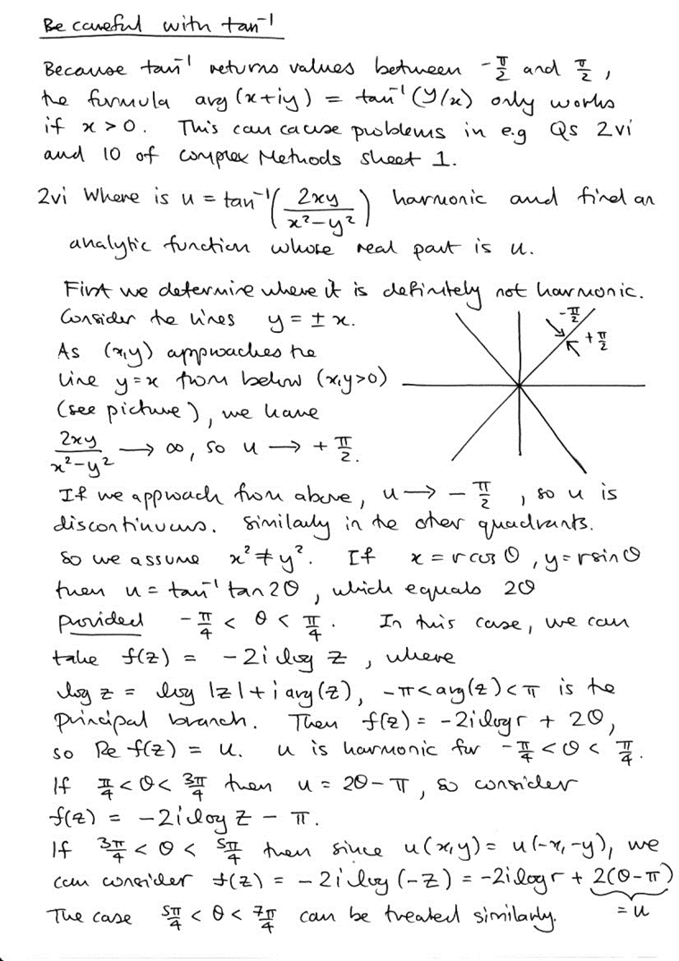
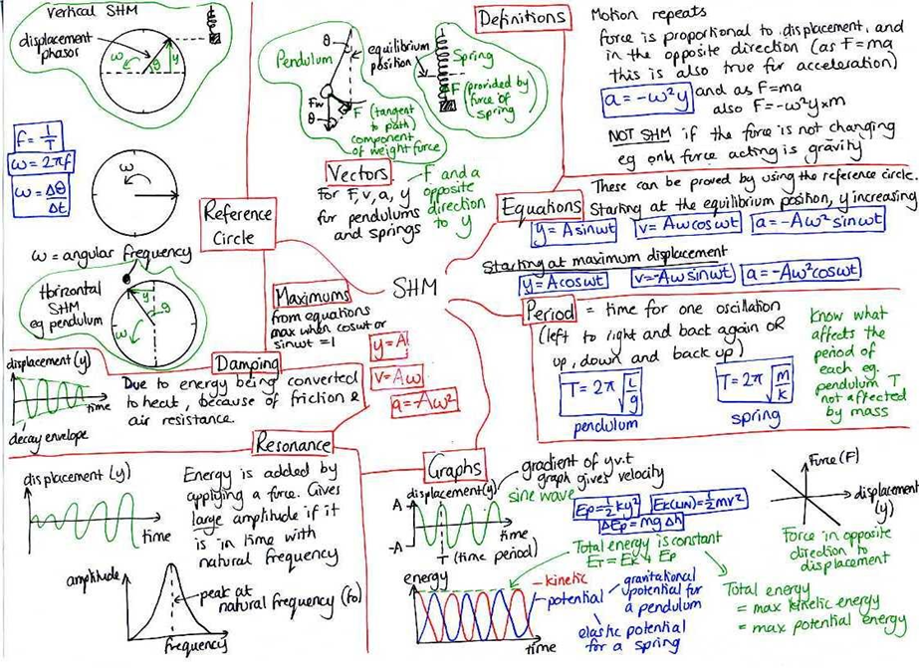
Notes:
Left: Left Brain
Rt: Right Brain
Whole brain people might be somewhere in the middle. Organized and linear but with some highlighting.
We need to teach students how to take notes and study/memorize information based on their brain dominance. Some right brainers will figure this out as time goes by but most will need to be shown. It makes a huge difference in the amount of time they will spend trying to memorize information and/or store it in their long term memory.

Slide 15

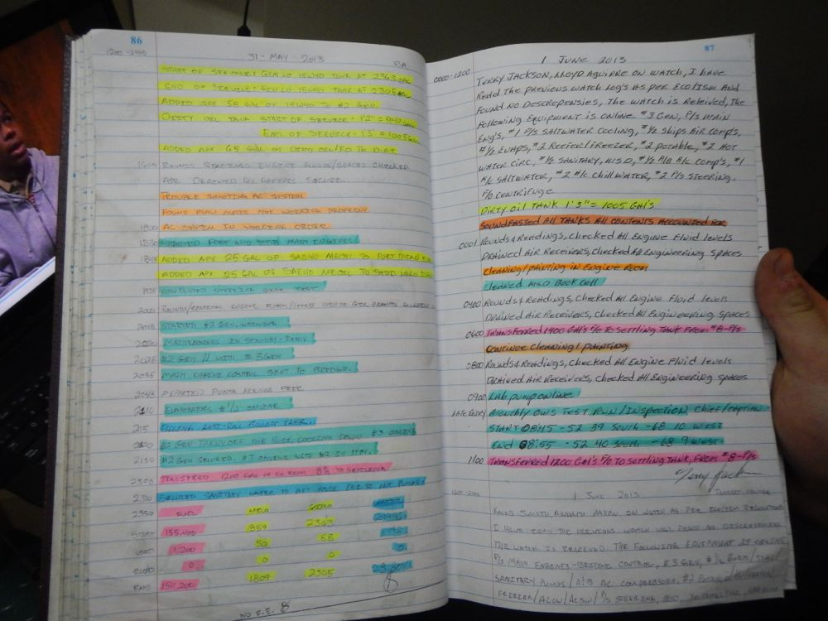

Slide 16

Humor
Lowers Blood Pressure
Laughing is a Release
Reduces Anxiety
Improves Outcomes
Improves Test Taking
Notes:
1 minute, 43 seconds
When we are happy, our amygdalae fire less, our prefrontal cortex is freer to function fully, we experience less stress, we think more clearly and creatively, we perceive more broadly, we are healthier, and we live longer. We simply function better and so are more successful. Traditionally, we tend to get a little louder each time we have to tell our teen to do the same task. By the time we truly get their attention, we are often yelling and mad. (Our own amygdala is unhappy!) If we can remember that there are biological reasons that our teen can’t remember we told them to do something, and that they become upset and overreact to our stern words, we can create a threat-free environment, the probability of success will be increased.

Slide 17
Impact The Mind With Color
Blue - Studying, Thinking, Concentration
Purple - Tranquilizing, Good for Appetite Control
Pink - Restful, Calming
White - Disrupting
Notes:
Colors impact the mind and body. Use colors while studying to promote specific feelings for specific tasks.

Slide 18
Color Continued...
Red - Creative Thinking, Short-Term Energy Boosts
Green - Productivity, Long-Term Energy
Pastels - Minimum Disruption Across All Moods/Activities
Yellow
Orange - Physical Work, Exercising, Positive Mood
Coral

Slide 19
Lavender, Lemon, Peppermint… Add Aroma
Lavender - Reduces Stress
Lemon - Induces Positive Mood
Peppermint - Refreshes & Invigorates
Apple - Relaxes Brain Waves & Reduces Blood Pressure
Vanilla - Relaxes & Soothes
Notes:
Add aromas! Smell is the only sense that has a direct connection to the limbic system. Scents can be used to keep students alert, and may help to embed memory.
Make learning more enjoyable and memorable through multisensory stimulation. Integrate sights, sounds, touch, taste and smells into your study environment whenever possible.
Remember- the brain memorizes in “events” - Aromas help create an event when memorizing information, especially if the students smells the same scent while studying/memorizing as he/she does while trying to recall the info on a test.
The hypothalamus is a part of the limbic system, which is a group of forebrain structures that has the hypothalamus, the amygdala, and the hippocampus. These are involved in motivation, emotion, learning, and memory. The limbic system is where the subcortical structures meet the cerebral cortex.

Slide 20
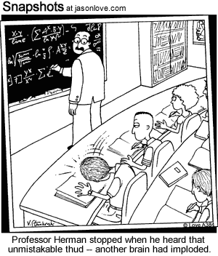
Allow Time To Process- Even At Home

Slide 21
traci.chudy@cps.k12.ar.us
THANK YOU!!!

Slide 22
